Slide 1


Microsoft User Group Ghana
Microsoft Community Ghana

Slide 2
What is MUGGH?
Microsoft user Group Ghana is a Microsoft community led by Abou Conde
The purpose of the User group is to share real world experiences, information about the latest product offerings by Microsoft, and also network with peers within the same market space
We also aim to give perspective to those who are new to the IT world, mentorship to those who need it, those who want to look up to somebody for advice, leadership and guidance and a community to grow in.
The group is hosted by the community for the community.

Slide 3
About MUGGH
We run periodic events, our events are posted on Meetup.
Everyone is welcome. Whether you are just trying to start out in IT, a seasoned professional, coming alone or with colleagues you are welcome
Everyone from any background is welcome at our events and the organizing team’s aim is to help further the careers of our attendees.
We would love it if you presented a session. If you are an aspiring speaker or you have done it many times before we would love you to speak
Real-world knowledge is valued by all attendees. If you’ve never spoken at a user group before we are happy to coach you.

Slide 4
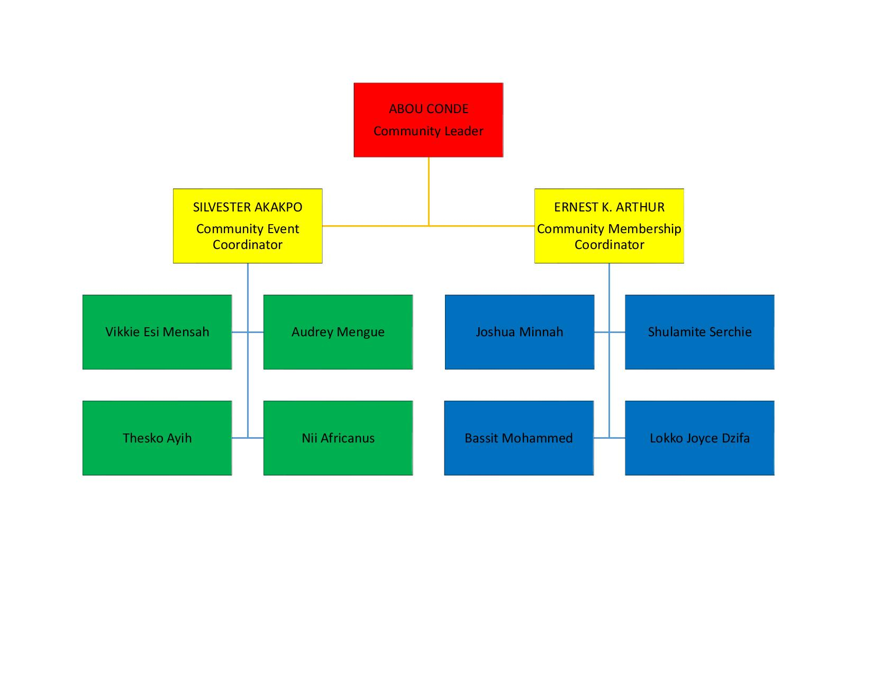
Event Organizers

Slide 5
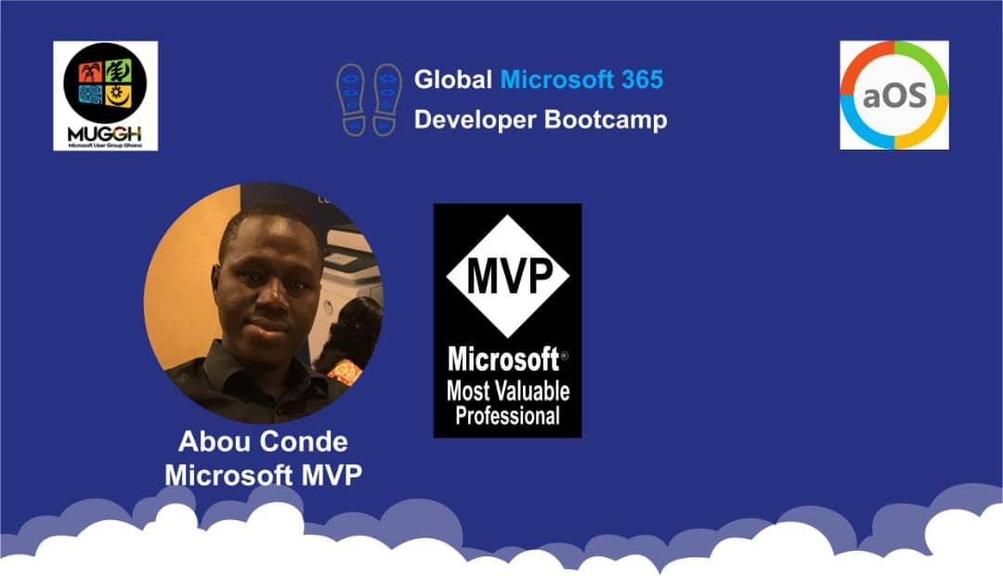
About Abou Conde
Abou is a Microsoft Azure MVP with over 9 years of experience in the industry. He focuses on Microsoft technologies. Starting as support engineer and Microsoft Certified Trainer at IPMC Ghana, he has worked up through the ranks of System Engineering, IT infrastructure Consultant and Cloud Solution Architect. He has deployed several complex solutions for Multi-national Corporations and Governmental Agencies. He is fluent in French and English.
Currently, Abou Conde works at Global Information Technology Solutions (GITS) IT Company in Ghana,and is the first MVP from Ghana. He is specialized in Enterprise Architecture both on-premise and in the cloud.
Linkedin : https://www.linkedin.com/in/abou-conde-33599527/
Twitter: https://twitter.com/abu_conde
Blog : https://abouconde.com

Slide 6





Past Events Highlights

Slide 7
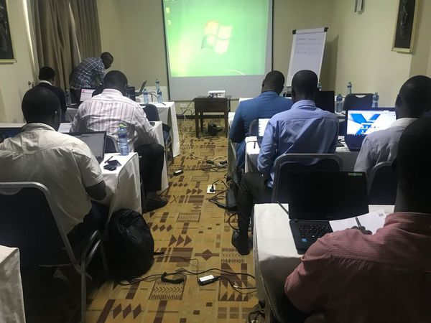
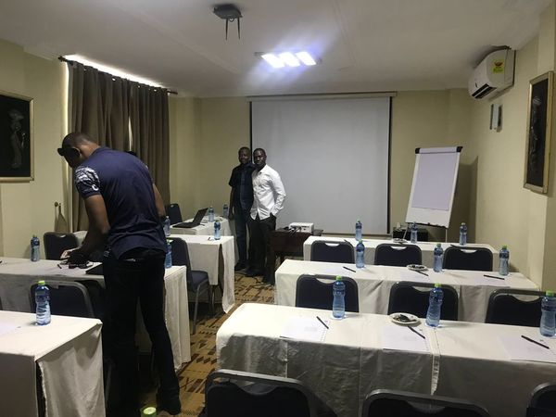
Microsoft 365 Training
4th /5th October 2018

Slide 8
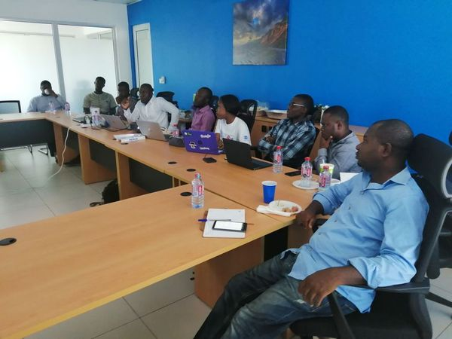
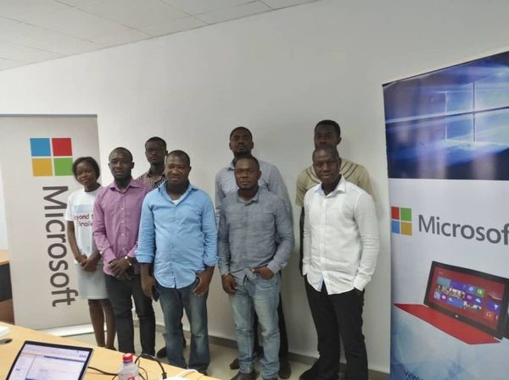
Visual Studio Launch
2nd April 2019

Slide 9
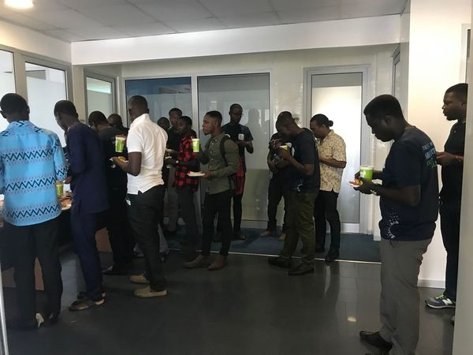

Azure BootCamp 2019
27th April 2019

Slide 10
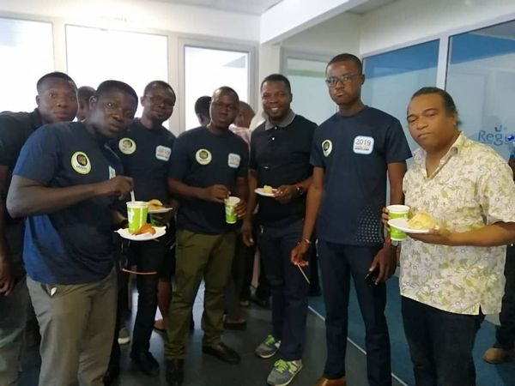
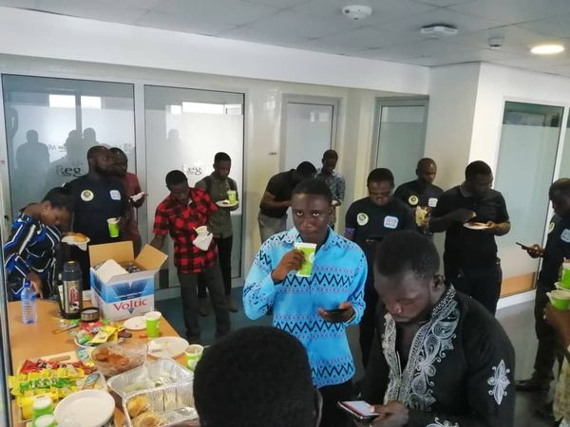
Azure BootCamp 2019

Slide 11
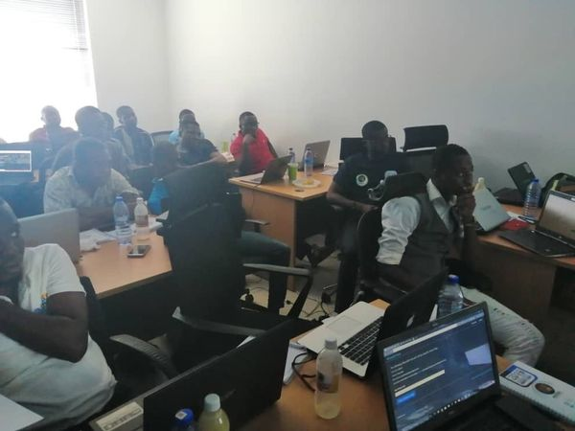
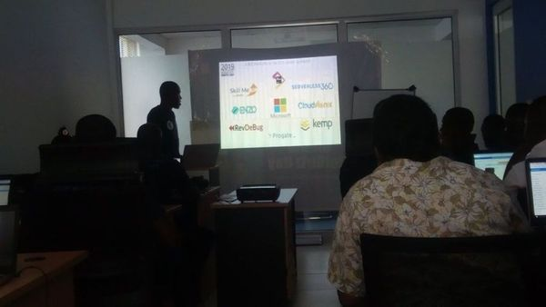
Azure BootCamp 2019

Slide 12
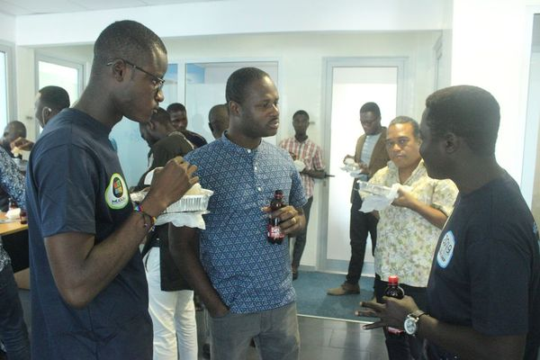
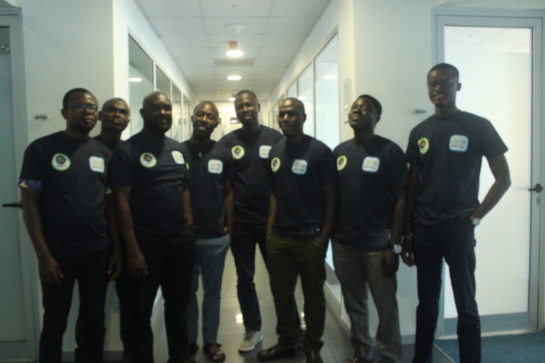
Azure BootCamp 2019

Slide 13
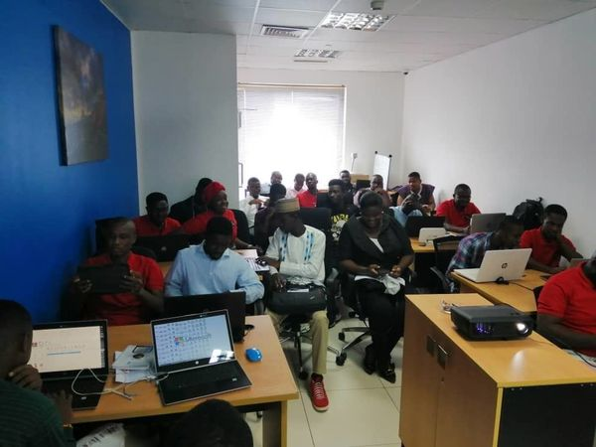
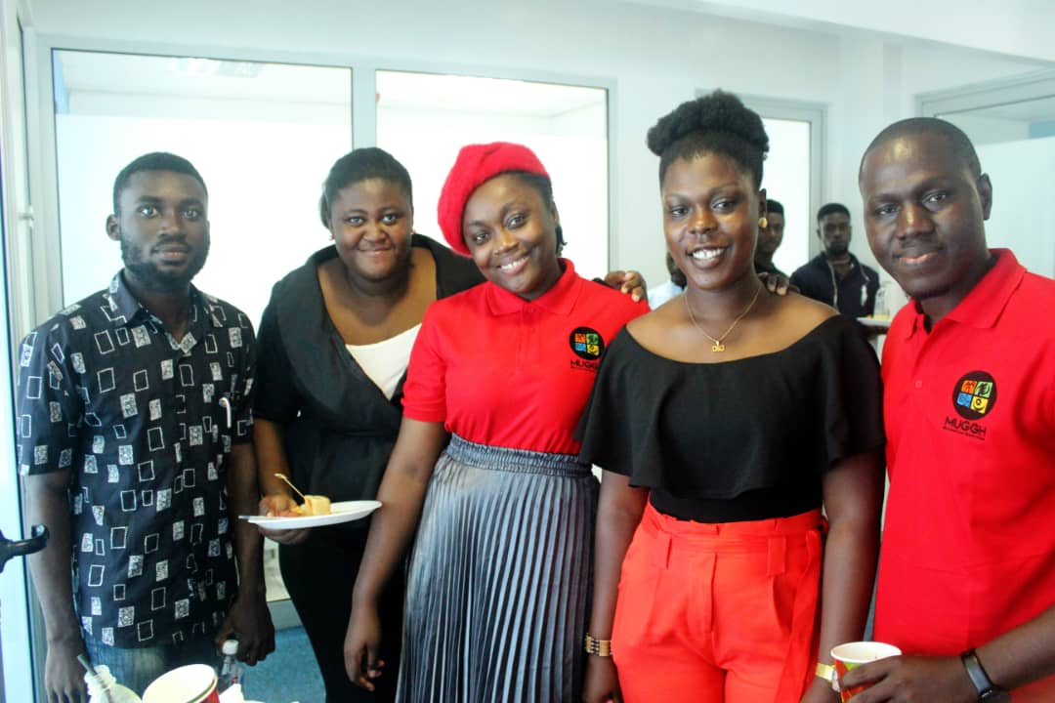
What is new in Server 2019?
28th June 2019

Slide 14
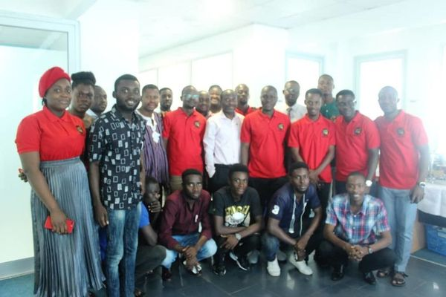
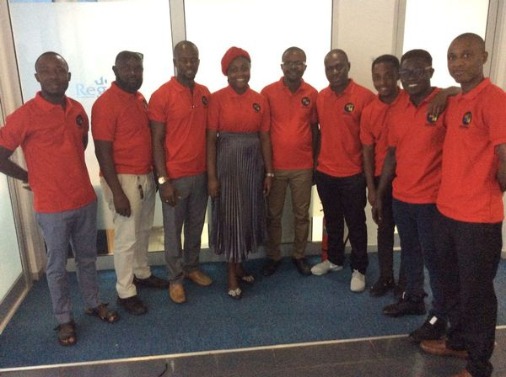
What is new in Server 2019?

Slide 15
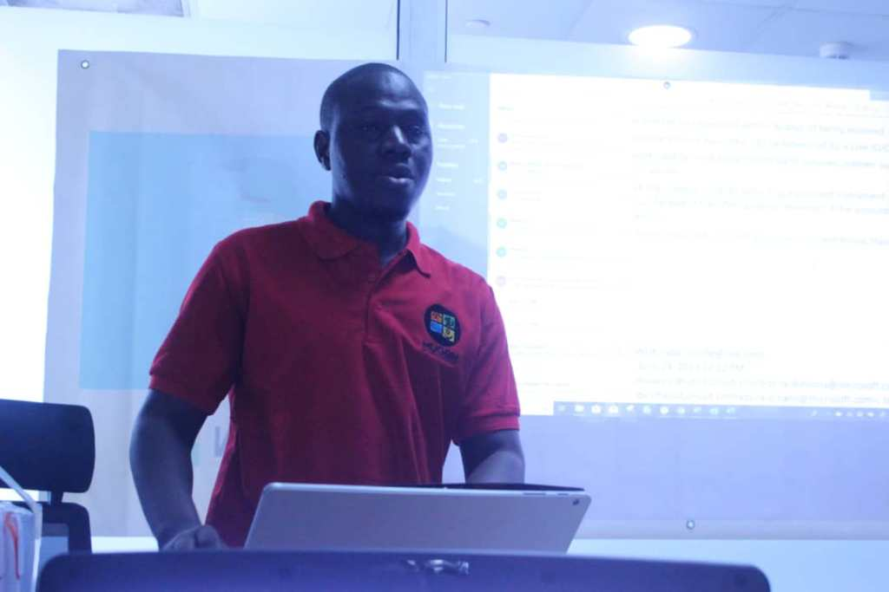
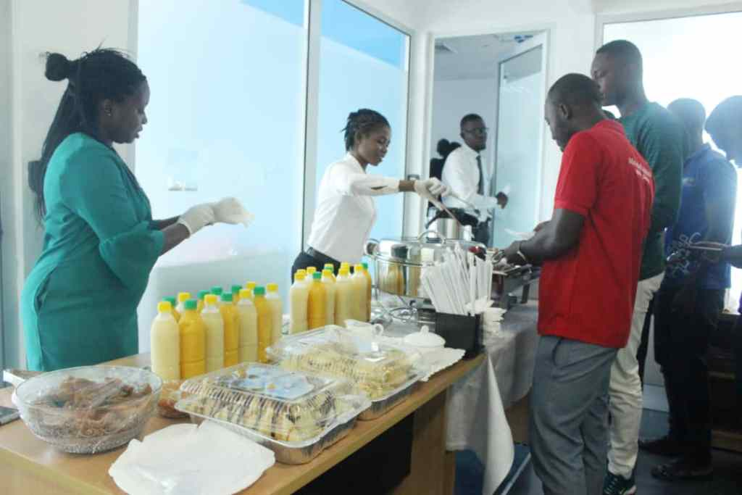
What is new in Server 2019?

Slide 16

UPCOMING EVENTS…

Slide 17

Global Microsoft 365 Developer Bootcamp 26th Oct 2019

Slide 18

Global Mixed Reality Bootcamp
16th Nov 2019

Slide 19
Global Microsoft 365 Developer Bootcamp(2) 30th Nov 2019

Slide 20

Global AI Bootcamp Ghana 14th Dec 2019

Slide 21
Join us
Linkedin: https://www.linkedin.com/groups/8728284/
Meetup: https://www.meetup.com/Microsoft-User-Group-Ghana
Twitter : https://twitter.com/mug_ghana @mug_ghana
Facebook: https://www.facebook.com/groups/355156248518498/

